Slide 1
EGB1121 - DATA STRUCTURES
PROJECT REVIEW
Department of Electronics and Communication Engineering
Academic Year: 2024 – 2025 (Even Semester)
Register Number : 2403811710622113
Name : SUJITHA M
Year : I
Semester : II
Section : L
Date : 11/06/25

Slide 2
Title of the Project
HOSPITAL PATIENT RECORDS MANAGEMENT SYSTEM USING AVL TREES

Slide 3
Abstract
The Hospital Patient Records Management System is a data structure-based project implemented in the C programming language, designed to efficiently store, manage, and retrieve patient information.
This system uses an AVL tree (a self-balancing binary search tree) to maintain patient records such as patient ID, name, and other relevant data. The AVL tree ensures that the height of the tree remains balanced after every insertion and deletion, thereby allowing faster search, insertion, and deletion operations in O(log n) time complexity.
This improves the overall performance of managing large volumes of patient records compared to unbalanced trees or linear data structures. The project demonstrates the application of advanced tree structures in real-world scenarios such as healthcare data management, where accuracy and quick access are critical.

Slide 4
Introduction
An AVL Tree is a self-balancing binary search tree that keeps the height difference between left and right subtrees within a limit after every insertion or deletion. This ensures that the operations like searching, inserting, and deleting patient records are performed quickly and efficiently. Each node in the AVL tree represents a patient, storing details such as patient ID, name, and other personal information.
This system helps maintain a well-organized, balanced, and dynamic structure for hospital data, allowing healthcare staff to manage records with speed and accuracy. The use of data structures like AVL trees in real-life applications showcases the importance of algorithm efficiency in software development.

Slide 5
Data Structures - Concepts Used
Maintaining Data Integrity - > self-balancing feature ensures that the tree
structure remains efficient and that data retrieval remains fast, even with
frequent updates to the patient records.
Handles Large Datasets - > AVL trees are well-suited for managing large
datasets, like a hospital’s patient records, because their logarithmic
time complexity ensures that performance remains efficient even as the

Slide 6
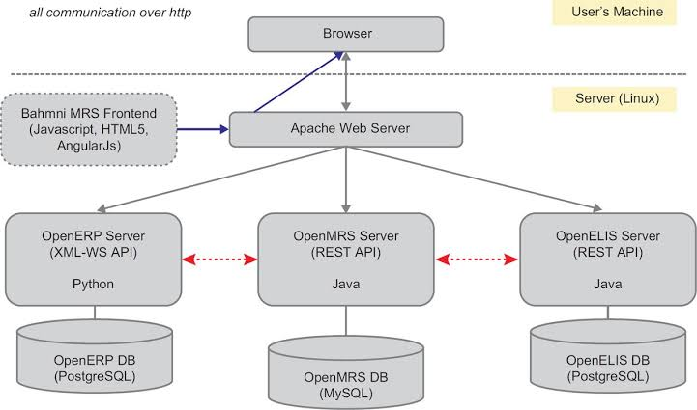
Proposed Architecture

Slide 7
Proposed Architecture - Description
The proposed architecture for the Hospital Patient Records Management System is a modular, web-based system that integrates multiple healthcare modules for patient record management, laboratory information, and resource planning. This architecture is an open-source hospital management system, and consists of three main components:
Frontend (User Interface)
Web Server Layer
Backend Components (Modular Servers)

Slide 8
List of Modules
Creative New Patient Record.
Display Patient Records.
AVL Tree Rotation And Balancing.
Utility Module(Height and Balance Functions).
Main Control Module.

Slide 9
Module Description
The Hospital Patient Records Management System developed using Data Structure and AVL Trees follows a modular approach to manage and operate on patient records efficiently.
Each module in the system is structured around a specific function that interacts with the AVL Tree, a self-balancing binary search tree used as the core data structure.
The AVL Tree ensures that all operations maintain logarithmic time complexity, which makes the system scalable and responsive.
The primary modules implemented in the project include patient record insertion, display of patient data, balance and rotation handling for the AVL Tree, and core utility functions that support the integrity and performance of the system.

Slide 10
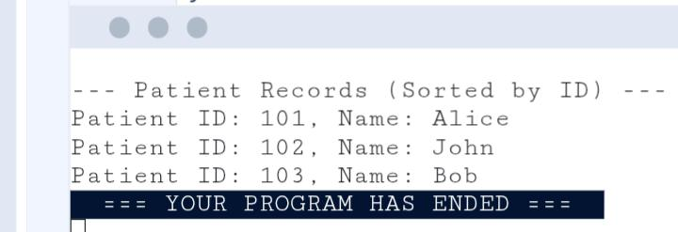
CODE OUTPUT

Slide 11
Results and Discussion
The Hospital Patient Records Management System was successfully implemented using the C programming language with an AVL Tree as the core data structure. The following results were observed during testing:
Efficient Data Insertion.
Fast Retrieval and Search.
Correct Tree Balancing.
Function Module Description.

Slide 12
Results and Discussion
This project demonstrated how data structure concepts like AVL Trees can be effectively used in healthcare applications for fast and structured data management. Compared to linear or unbalanced tree structures, the AVL Tree maintained a consistent and optimal performance, particularly as the number of patient records increased.
The system proves to be a scalable, high-performance solution for hospital record management using basic but powerful data structures in C.

Slide 13
Conclusion
The Hospital Patient Records Management System using AVL Trees in C demonstrates how efficient data handling can be achieved through self-balancing binary search trees. By maintaining balance after every insertion and deletion, the system ensures fast access to patient records, making it suitable for real-time hospital use.
The implementation highlights the importance of data structures in building scalable and responsive applications, while also reinforcing key C programming concepts like pointers, dynamic memory, and modular design.
Overall, the project is efficient, maintainable, and provides a solid foundation for future enhancements in healthcare systems.

Slide 14
Thank You

